Slide 1

Linux on demand
Fog and Cloud Computing project 20/21 – Group 03
Muhammad Uzair Aslam - ID: 223245
Giuseppe Superbo – ID: 220376

Slide 2
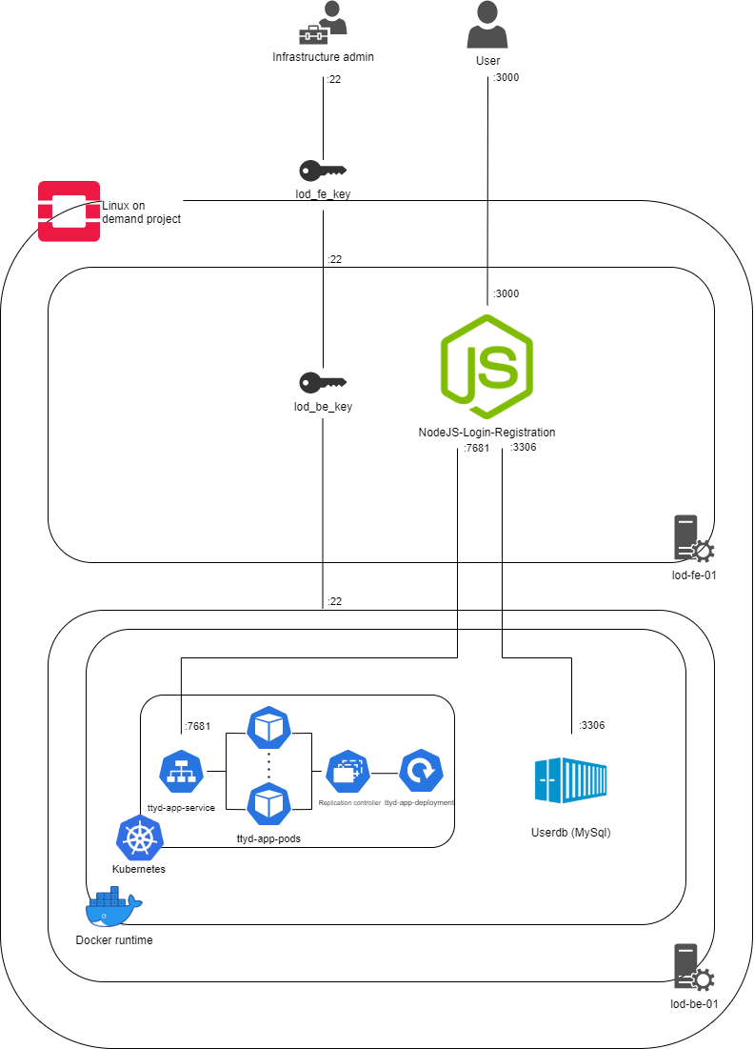
Infrastructure architecture
Purpose of the infrastructure: providing a Linux sandbox environment
Used technologies for the infrastructure: OpenStack, Kubernetes, docker
Used technologies for the application: nodejs, mysql, ttyd
Deployment automation managed by: terraform, cloud-init, bash scripting

Slide 3


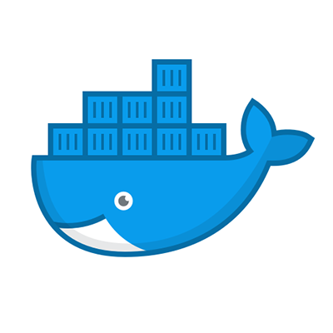

What we are going to show
Demonstration of the working application
Terraform infrastructure and project management
Cloud-init and bash scripting automation
MySQL docker container configuration
Kubernetes deployment and service configuration

Slide 4
Thank you for your attention!
Any questions?

